Slide 1



Customer & Sales on Shopee Brazil
Sales Data 08-2019 to 01-2023

Slide 2
Introduction
Analyze data with 2 objectives
Understand Shopee Customers in Latin America
Make recommendation to improve customer experience and revenue
Dataset on Customer and Purchase were provided. The additional data preparation work were done in Power Query
Classify Age, Income, Discount, Delivery Lead Time, Shipment Cost into separate bucket
Remove Product Description
Define new Table for Date
Define new table with product name classify into different category
Refer to Appendix on new tables and columns

Slide 3

Telling my Story
Customer Segment (Power BI)
Demographic
Geographic
Relationship to Sales
Other Insights (Power BI)
Discount, Shipping Cost
Delivery Lead Time
Recommendation (PowerPoint)
By Customer Type
Improvement Plan
Insights on Behavior (Power BI)
By Country
Buying Patterns

Slide 4
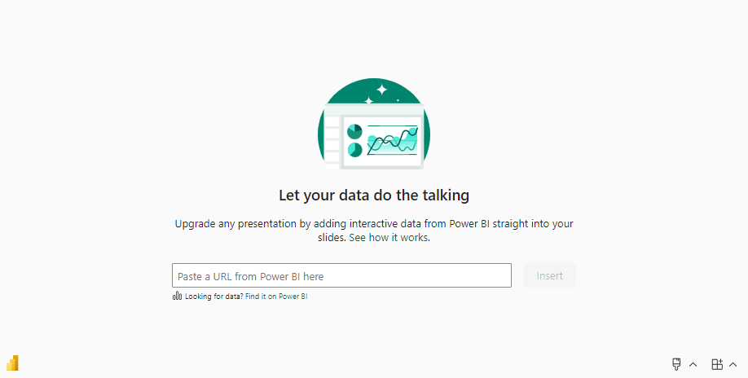
Power BI

Slide 5
Recommendation by Customer Type
Insights on | Identify Type of Customer | Action
1. Sales by Country by Product | Customer that purchase less of certain product | Conduct Customer Survey to understand whether is the Product, Price or Portal that they dislike Recommend product of their interest Advertise new models of product
2. Customer Behavior | Customer that spend less in General
 | Loyal Customer | Focus on Loyalty Program - Cashback, Points Redemption, Early Sales Preview Email Statement on rewards earned Establish a Membership Tier to motivate more purchase Advertise exclusive benefits for customers on high Membership Tier
 | Bargain Hunter | Communicate discounts & product offers Consider implementing Group Purchase Program

Slide 6
Recommend Improvement Plan
Insights on | Situation | Action
3. High Shipping Cost | Shipping cost is usually a fraction of Sales. Observed high shipping cost for 25% of Fashion Sales. For many orders, shipping cost is more than cost of the product. Fashion products expect to repeated purchase. Address this issue will delight customer and increase overall sales. | Work with merchants on the reasons for high shipping cost Recommend Transport and Logistic Service provider to the Merchant Consider implement a self collection point
4. Long Delivery Lead Time | Orders ship within 3 days is acceptable Here’s the statistics for 2020, 2021 and 2022 25% shipped within 3 days after the order date. 25% shipped between 4-7 days after the order date. 50% shipped between 8-15 days after the order date. | Set up a KPI to monitor the situation Identify the reasons on why shipment date is delayed Work with Merchant to improve the shipment date

Slide 7

Summary
C
Improve Delivery Lead Time
Reduce Shipping Cost
Conduct Survey
Recommend Products
Advertise new models
Customer buying
Less of a specific
Product
Conduct Survey
Recommend Products
Advertise new models
Loyal
Customer
Customer
Buying Less
in General
Royalty
Program
Bargain Hunter
Communicate
Discounts, offers,
Initiate Group Purchase

Slide 8
Q & A
Q & A

Slide 9
Appendix 1
Table | Column Name | Description | Formula | Type
customer | Bucket_Age | Classify Age into separate bucket | Age =< 34 is "Junior" Age between 35-54 is "Adult" Age > 55 is "Senior" | STRING
customer | Bucket_Income | Classify Income into separate bucket | Income =< 60k is "Low" Income =< 100k is "Medium" Income > 100k is "High" | STRING
purchase | Sales | Duplicate from Price Column | Sales = Price | Decimal
purchase | Bucket_Discount | Classify discount amount into separate bucket | 10, 20, 30, 40 and 50 | STRING
purchase | ShipCostRatio | Compute the shipping cost over the sales | shipment cost / sales | Decimal
purchase | Bucket_Shipcost | Claissify shipment cost into separate bucket | 10, 20, 30, 40, 50 and >50 | STRING
purchase | LeadTimeDelivery | Compute the number of day needed to ship the product | Shipment Date minus Order Date | STRING
purchase | Bucket_DeliveryLeadTime | Classify Delivery Lead Time into separate bucket | =< 3 days, "Pass within 3 Days" Between 4-7 days, "Unreasonable 4-7 Days" > 7 days, "Fail > 7 Days" | STRING
PRODUCT | Product_name | Extract from purchase[product_name] |  | STRING
PRODUCT | Category | Classify product_name into separate bucket | see next slide on classification | STRING
DATE | Date | Date range from 01/01/2019 to 31/01/2023 | DATE = Calendar(“01/01/2019”,”31/01/2023”) | Date
Back

Slide 10
Appendix 2
product_name | Category
Rugs | Décor
Curtains | Décor
Wall Art | Décor
Home Decor | Décor
Dress | Fashion
Shoes | Fashion
Formal Shirt | Fashion
Skirt | Fashion
Sports Shoes | Fashion
Activewear Set | Fashion
Jacket | Fashion
T-Shirt | Fashion
Sweater | Fashion
Jeans | Fashion
product_name | Category
Appliance Set | Fixtures
Lighting | Fixtures
Kitchen Appliances | Fixtures
Furniture | Furniture
Dining Set | Furniture
Bedding | Furniture
Virtual Reality Headset | Technology
Tablet | Technology
TV | Technology
Camera | Technology
Smart Watch | Technology
Laptop | Technology
Headphones | Technology
Wireless Speaker | Technology
Gaming Console | Technology
Smartphone | Technology
Back

Slide 11
Appendix 2
product_name | Category |  | product_name | Category
 |  |  | Appliance Set | Fixtures
Rugs | Décor |  | Lighting | Fixtures
Curtains | Décor |  | Kitchen Appliances | Fixtures
Wall Art | Décor |  | Furniture | Furniture
Home Decor | Décor |  | Dining Set | Furniture
Dress | Fashion |  | Bedding | Furniture
Shoes | Fashion |  | Virtual Reality Headset | Technology
Formal Shirt | Fashion |  | Tablet | Technology
Skirt | Fashion |  | TV | Technology
Sports Shoes | Fashion |  | Camera | Technology
Activewear Set | Fashion |  | Smart Watch | Technology
Jacket | Fashion |  | Laptop | Technology
T-Shirt | Fashion |  | Headphones | Technology
Sweater | Fashion |  | Wireless Speaker | Technology
Jeans | Fashion |  | Gaming Console | Technology
 |  |  | Smartphone | Technology
Back

